Slide 1
By Diana Bolgare Freelance Riga, Latvia 2024

Slide 2
WHAT?
Poetry recitation contest

Slide 3
WHY?
Poems are short
A dynamic way to introduce students to poetry
Easy to implement
Inspires learning

Slide 4
WHEN?
2024/25 School year Online phase October 2024
Offline Finals 30 November 2024 Riga, Latvia

Slide 5
HOW do we bring Poetry in My Heart to students?
A teacher makes Poetry in My Heart optional to all their students to receive extra credit.
A student records a poem and submits the link to the file with their reading to the judges via the Google Form until 6 October https://forms.gle/Q1rdNqNvB4diHrcz7
The winners of the online phase move on to the next level of the competition – offline finals.
The winner of the offline finals receives a valuable prize (to be discussed and confirmed).

Slide 6
Let’s start
1. Explore the poems
https://www.poetryoutloud.org/search/?type=poem
https://www.poetrybyheart.org.uk/poems

Slide 7
Let’s start
2. Discuss the chosen poem.
3. Help students memorize the poem.
4. Record the poem.
5. Send the link via Google Form https://forms.gle/Q1rdNqNvB4diHrcz7

Slide 8
Let’s continue
6. Offline Finals (30.11.2024 – a 1hour day-time event )
7. Reciting a new poem
8. Creative writing
9. Presenting creative writing
10. Choosing the winner

Slide 9
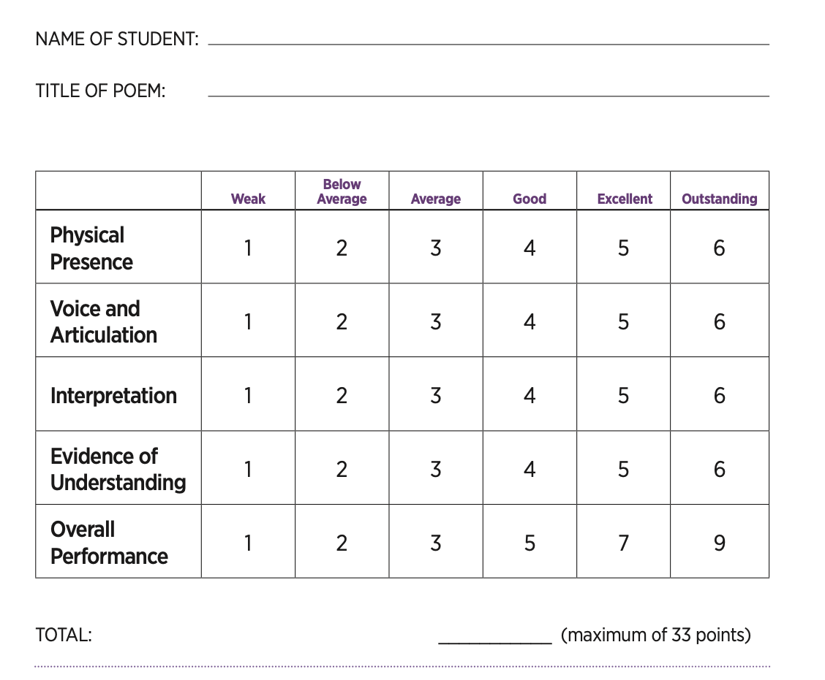
Judging and scoring
Poetry Out Loud evaluation sheet
2 judges (1 English world, 1 Theatre world)

Slide 10
Rules:
Memorization: Students must recite their poems from memory.
Props: Students may not use props or wear costumes during their recitations.

Slide 11
Rules for recording a poem
Vertical Instagram format.
Filming on a phone.
The background should be either aesthetic or plain.
Learn the lines by heart - Don’t read.
The shot should be framed from the waist up or shoulders up.
Clothing should be in calm colors.

Slide 12
Creative Writing
6. Include creative writing exercises

Slide 13
Creative Writing
N + v + adverb
Preposition + pronoun. Pronoun.?!
Poetry Frames
Wizards are here.
Among us. You?

Slide 14
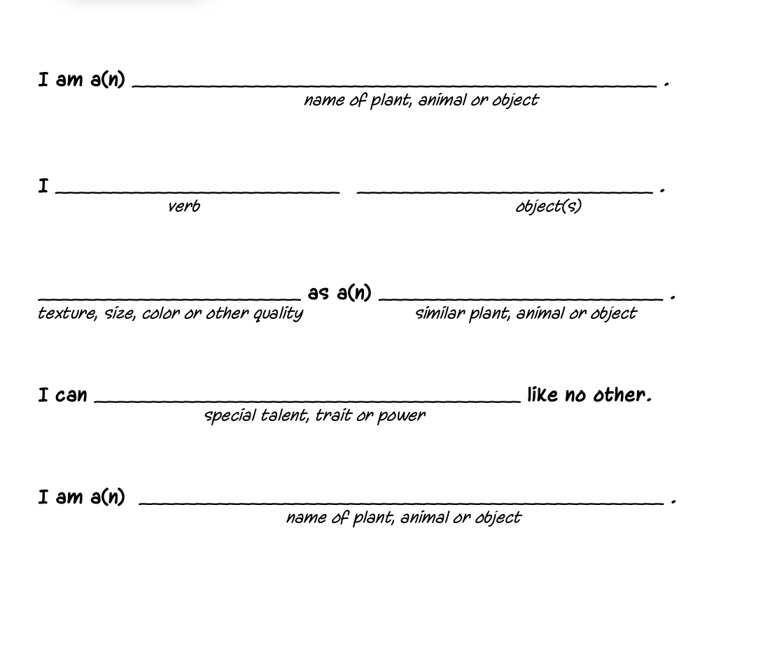
Creative Writing
an “I am” poem

Slide 15
Creative Writing
Noun
Adj Adj
Gerund Gerund Gerund
Phrase
Synonym
Diamond Poems
Grammar
Hard tough
Thinking, Writing, Confusing
Needed for IELTS test.
Hell
David F.

Slide 16
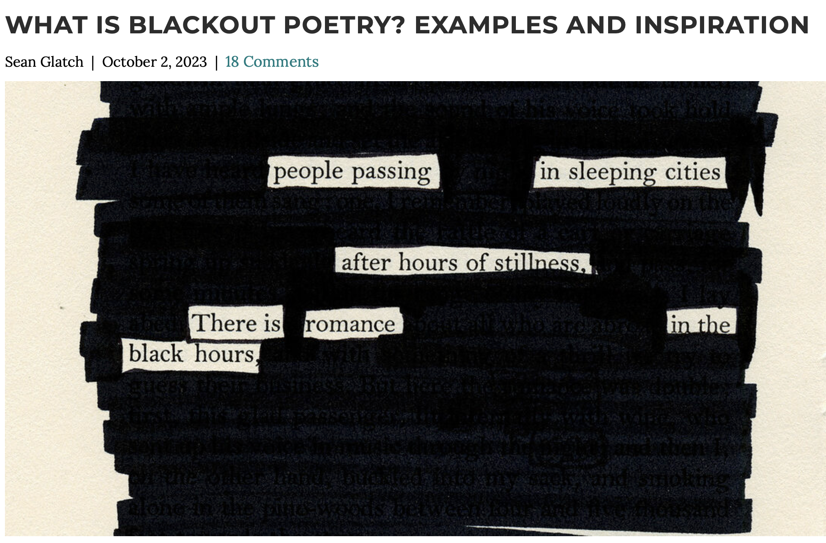
Creative Writing
Blackout Poetry

Slide 17
Creative Writing
Distinguished
Aspiring
Venturesome
Interesting
Debonair
Name Acronym

Slide 18
371 22300743
Diana Bolgare
Poetry in my Heart project https://poetry.dlc.lv/en/
The video filmed during the LATE conference 24.08.2024 https://vimeo.com/1002199994
To join the Telegram group of teachers-participants https://t.me/+mMR8dC-l9zc3NWM0
Let’s keep in touch!

