Slide 1

Poetry recitation contest 2026. Guidelines for teachers
By Diana Bolgare
Freelance
Riga, Latvia
2026

Slide 2
Contest at a glance
01 WHAT
02 WHY
03 WHEN
Poetry recitation contest
A clear framework for teachers and students.
• Poems are short
• A dynamic way to introduce students to poetry
• Easy to implement
• Inspires learning
ONLINE PHASE
September–30 October 2025
OFFLINE FINALS
29 November 2026
Theatre Museum
Ed. Smiļģa iela 37, Riga, Latvia

Slide 3
How to take part
Teachers may offer participation as optional extra-credit work.
01 CHOOSE
02 PREPARE
03 SUBMIT & ADVANCE
Explore poems from:
1 Discuss the chosen poem
2 Help the student memorize it
3 Record the performance
Send the recording via Google Form
by 30 October 2025
• A parent or guardian submits the form.
• Online winners advance to the offline finals.
• The final winner receives a valuable prize; details will be confirmed.
Poetry Out Loud
Poetry By Heart
Poets.org
Or another suitable source

Slide 4
Prepare the poem in three layers
Move from understanding the text to finding the voice, then shaping the performance.
01 UNDERSTAND
02 VOICE
03 PERFORM
• Summarize the poem
• Identify literary devices
• Describe the mood
• Explain why and uncover the hidden message
• Note the title, author, word count, illustration and full poem
• Relaxation and breathing
• Resonance and voice projection
• Vocal warm-ups
• Intonation, stress, rhythm and pauses
• Body language and gestures
• Facial expressions
Reference: Lesson Plan 29, “Literature in a Foreign Language Class” — Erasmus+ cooperation project.

Slide 5
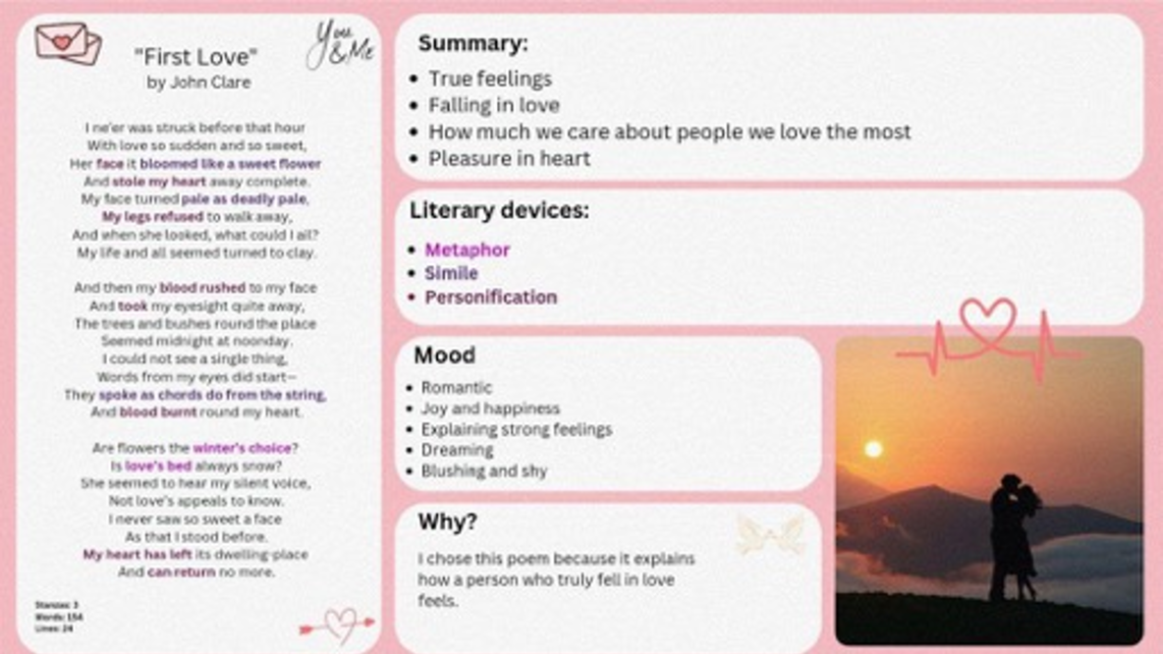
Worked example: “First Love”
LEVEL 1 IN PRACTICE
A one-page analysis brings together:
• Summary
• Literary devices
• Mood
• Why the poem matters
Use this structure as a model for students.

Slide 6
What happens at the offline finals
29 November 2026 · 12:00–14:00 · Riga
A focused two-hour programme moves from performance to creativity and recognition.
01 RECITE
02 CREATE
03 PRESENT
04 SELECT
A new poem
Students begin with a fresh recitation.
Creative writing
Students aged 15–18 complete a writing task.
Share the work
Students present their creative writing.
Choose the winner
Judges review the work and name the winner.
The sequence gives every finalist a clear path from recitation to a final decision.

Slide 7
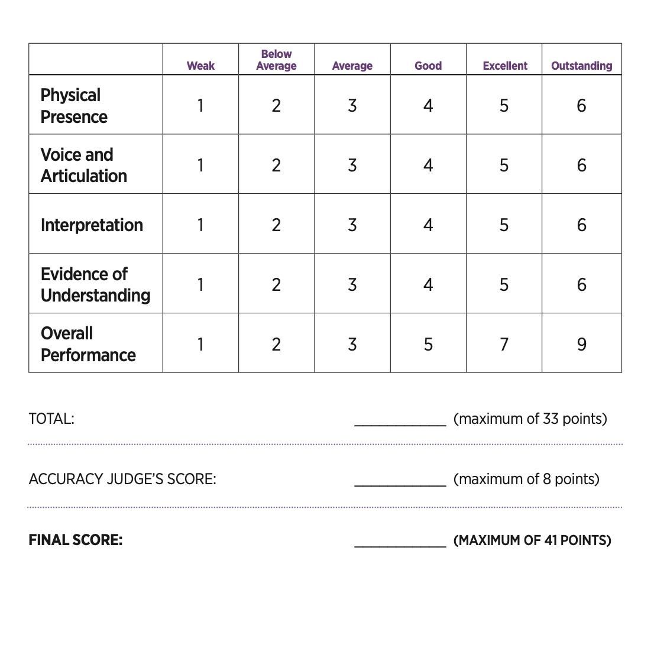
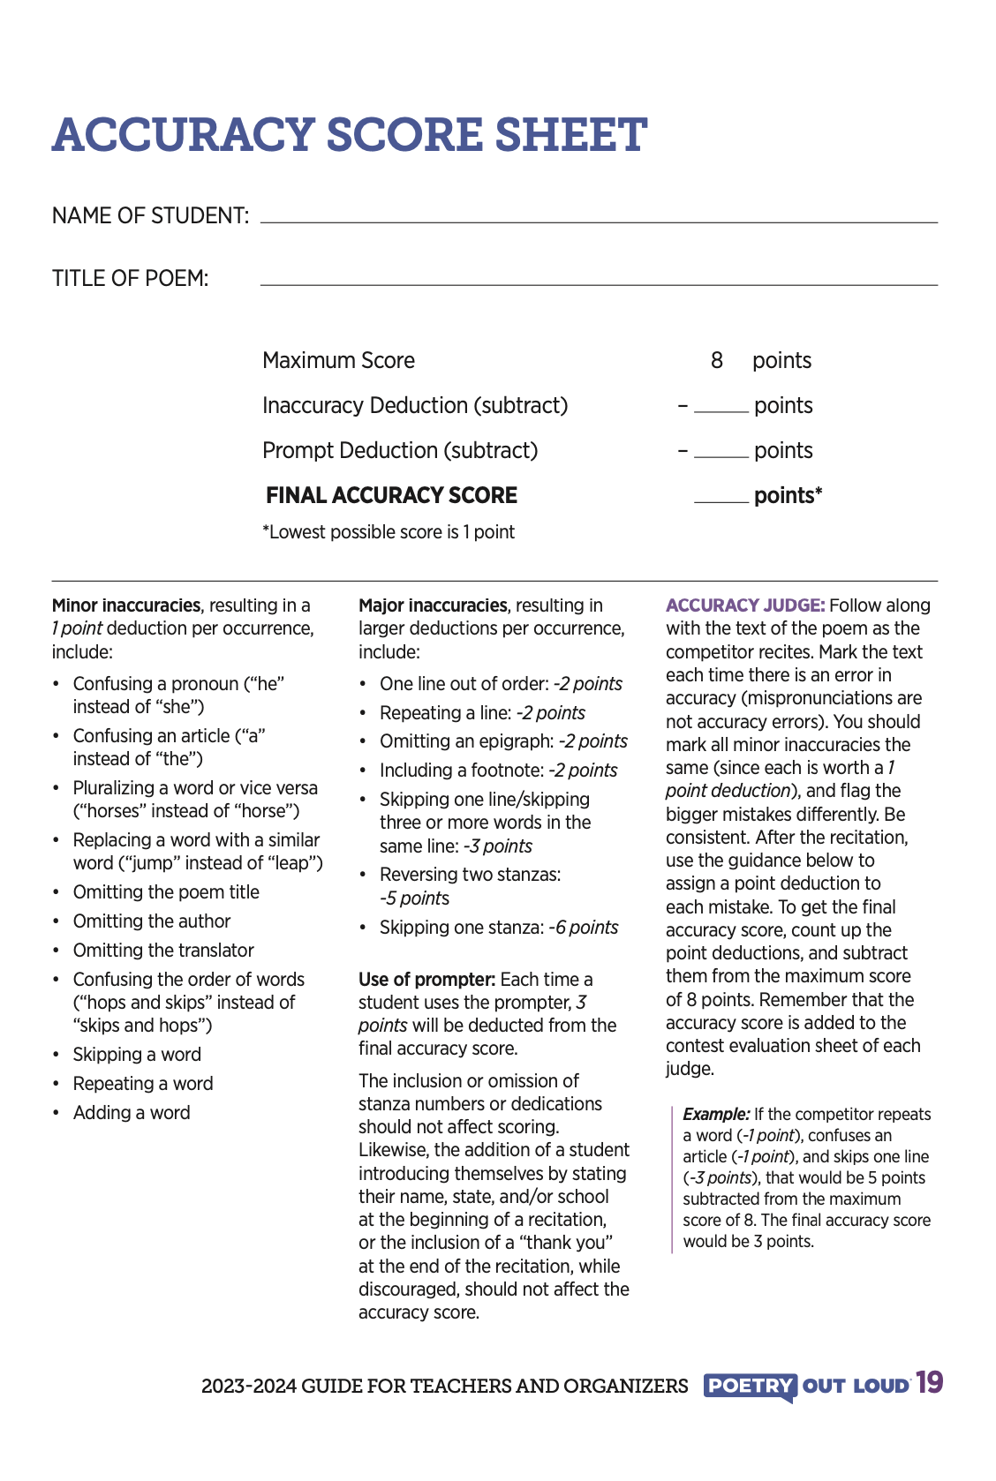
Judging combines performance and accuracy
Two judges score the performance; an accuracy judge adds a separate score for precise recitation.
01 PERFORMANCE
PERFORMANCE EVALUATION
ACCURACY SCORE
Score five dimensions
Maximum: 33 points
02 ACCURACY
Deduct for inaccuracies
Maximum: 8 points
03 FINAL SCORE
Maximum: 41 points
Recite from memory.
No props or costumes.

Slide 8
What the judges recommend
NADEZHDA PIKULEVA
ILONA BUCKMASTER
Think through gestures and glances from the start.
Choose a poem that suits the student’s nature, so the student and poem feel comfortable, natural and clear together.
Treat the competition as a game and an experience. Ask: “What can I do differently? How can I make this easy?”
Learn the poem well in advance.
Perform it for your class or another listener. Practice reduces public-speaking stress and creates more space for sincerity and expression.
Do not feel like a person being evaluated. Feel like a person who came to share a reading.
The shared message: prepare early, stay natural and focus on communicating the poem.

Slide 9
Record a clear, confident performance
Keep the setup simple so attention stays on the student and the poem.
01 SET UP THE SHOT
02 DELIVER THE POEM
• Use a vertical Instagram format.
• Film on a phone.
• Choose an aesthetic or plain background.
Memorization: Students must recite their poems from memory.
Props: Students may use props or wear costumes during their recitations.
Framing: Frame the student from the waist up or shoulders up.
Before submitting, check that the voice is clear and the student remains fully in frame.

Slide 10
Finalists (age 15-18) complete blackout poetry plus one surprise format
Four poetry formats · blackout poetry is obligatory; one other format is revealed on the spot.
01
02
03
04
“I AM” POEM
DIAMOND POEM
BLACKOUT POETRY
ACRONYM
Build a voice through repetition.
Shape one idea in seven lines.
Find a new text inside an old page.
Build a portrait or idea through initials.
Prepare all four—the surprise format is selected from the other three.

Slide 11
Two quick prompts help students begin
Both activities offer a simple structure without deciding the final meaning for the writer.
01 POETRY FRAME
02 NAME ACRONYM
Pattern
Noun + verb + adverb
Preposition + pronoun
Pronoun … ?!
Example: Wizards are here. Among us. You?
Use each letter of a name to begin a describing word.
D Distinguished
A Aspiring
V Venturesome
I Interesting
D Debonair
Use these as warm-ups before moving to longer forms.

Slide 12
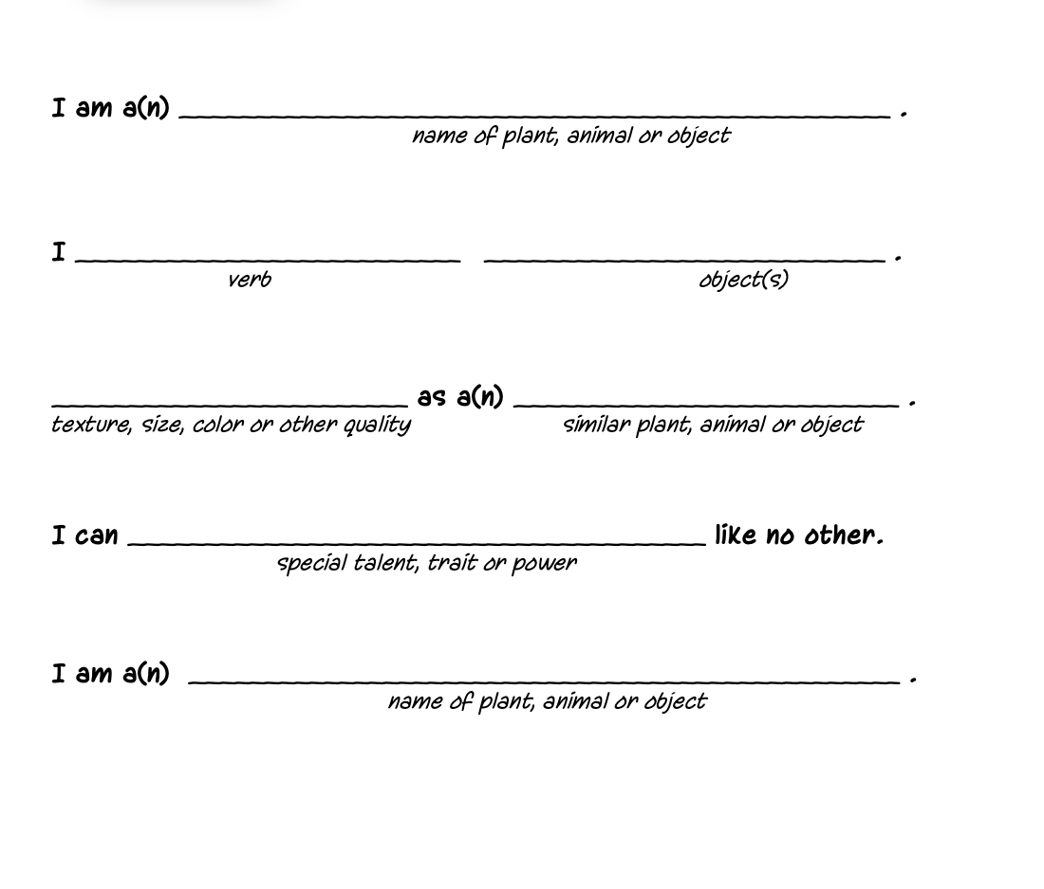
The “I am” poem builds a voice through repetition
Students repeat the opening phrase while changing the image, action and comparison.
PROMPT SEQUENCE
I am a(n) …
I … (verb + object)
… as a … (comparison)
I can … like no other
I am a(n) …

Slide 13
A diamond poem compresses one idea into seven lines
The widening and narrowing structure helps students move from a subject to a related ending.
THE PATTERN
NOUN
ADJECTIVE · ADJECTIVE
GERUND · GERUND · GERUND
A SHORT PHRASE LINKS THE IDEAS
GERUND · GERUND · GERUND
ADJECTIVE · ADJECTIVE
SYNONYM
The structure creates discipline without limiting the topic.

Slide 14
Three diamond poems show how structure changes tone
Each example follows the same form but arrives at a different emotional result.
Quiet, difficult
Making-to-believe
Starting and ending
But which never ends
A culture, not a history
A chance
Creative, passionate
Thinking, fighting, surviving
The creation of God
Mortal
Slow, hurtful
Crushing, shattering, scaring
Never again
Hurt
Watch example
Watch example
Watch example

Slide 15
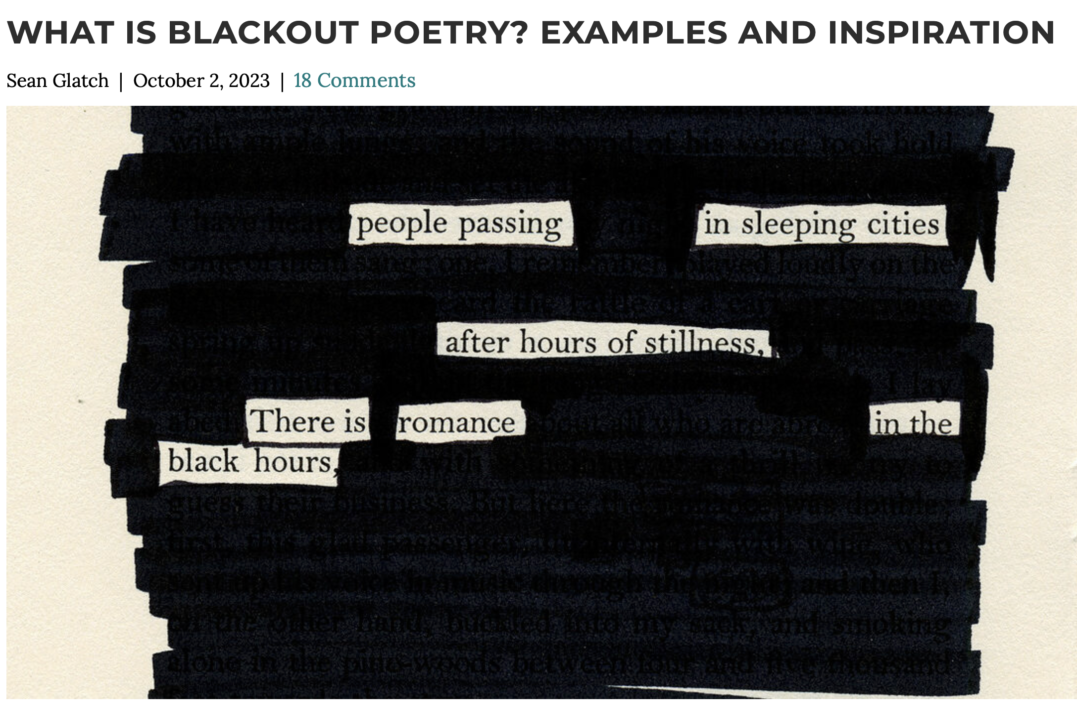
Blackout poetry creates meaning by subtraction
Students discover a new poem by selecting a few words and obscuring the rest.
THREE MOVES
1 Scan the page for words that connect
2 Keep only the words the poem needs
3 Black out everything else
Read the remaining words in their new order.

Slide 16
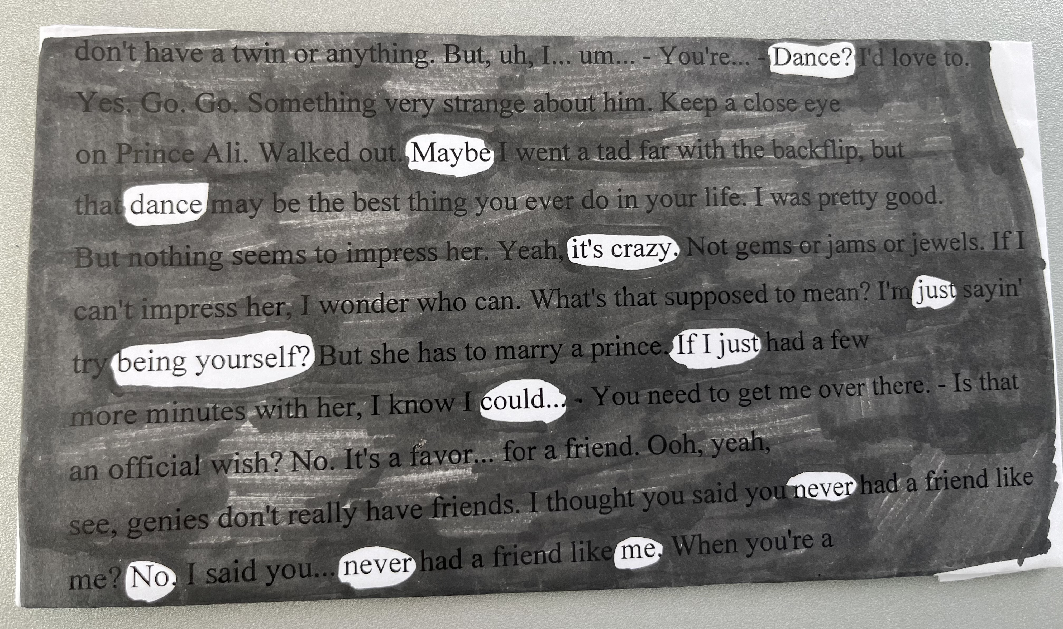
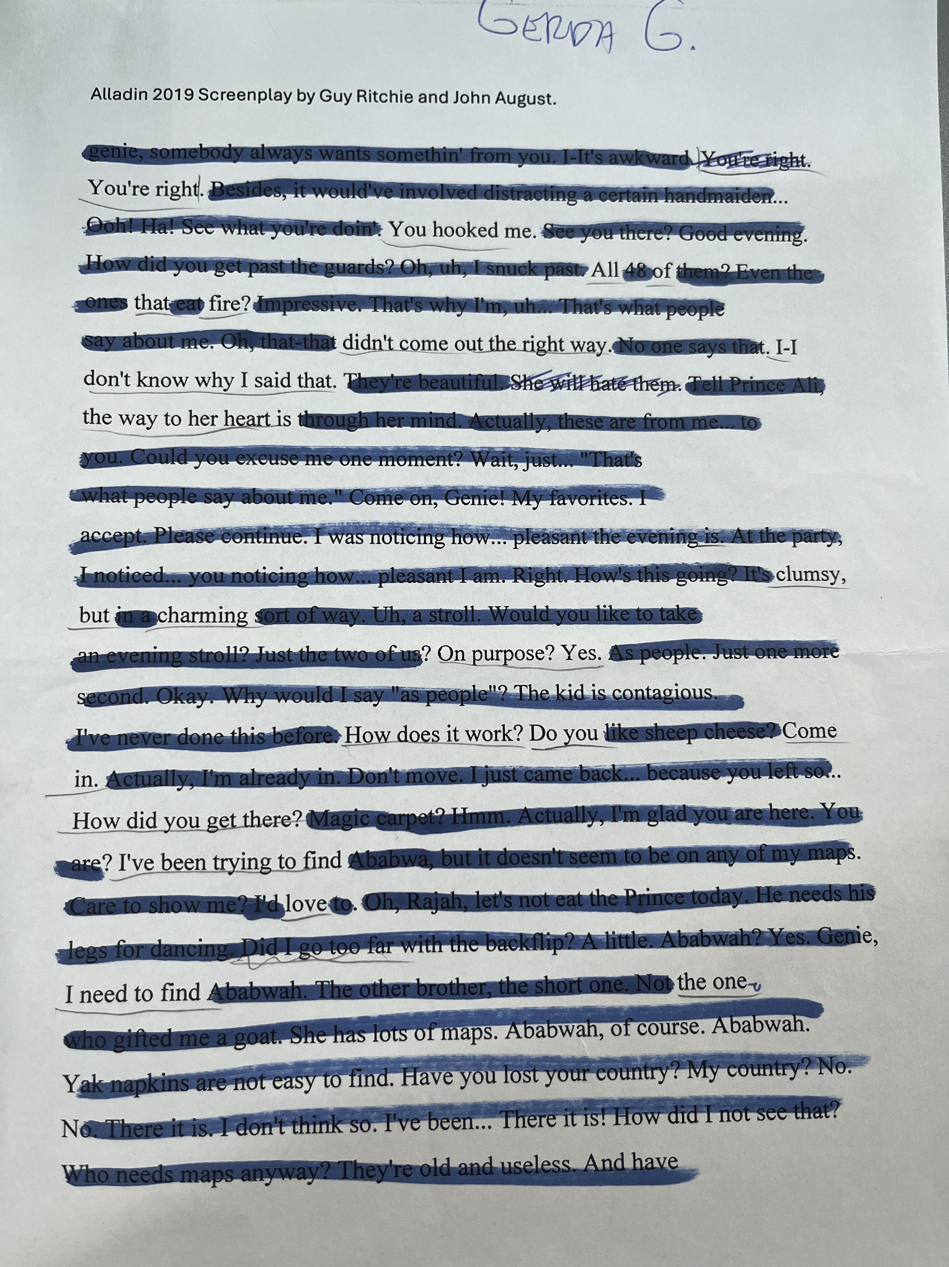
Two student examples show how few words can carry a story
Examples from Poetry in My Heart 2024 · compare word choice, rhythm and visual treatment.
01 EXAMPLE
02 EXAMPLE
Watch example
Watch example

Slide 17
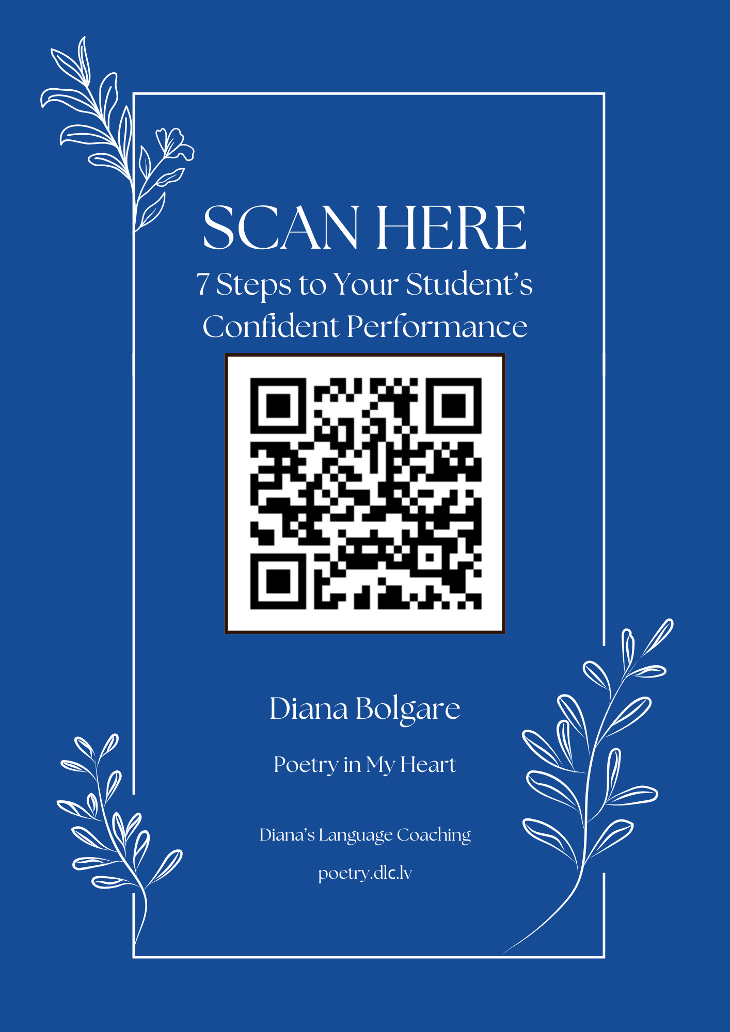
Stay connected with Poetry in My Heart
CONTACT
Diana Bolgare
diana@dlc.lv
+371 223 00743 · SMS
CONTEST 2026
Poetry in My Heart
poetry.dlc.lv
Scan the guide for seven steps to a confident performance.

